Slide 1
Broad Overview of Progress in Superconducting Frequency Multiplexed Detector Readout Systems
Ryan Stephenson, Adrian Sinclair, Phil Mauskopf

Slide 2
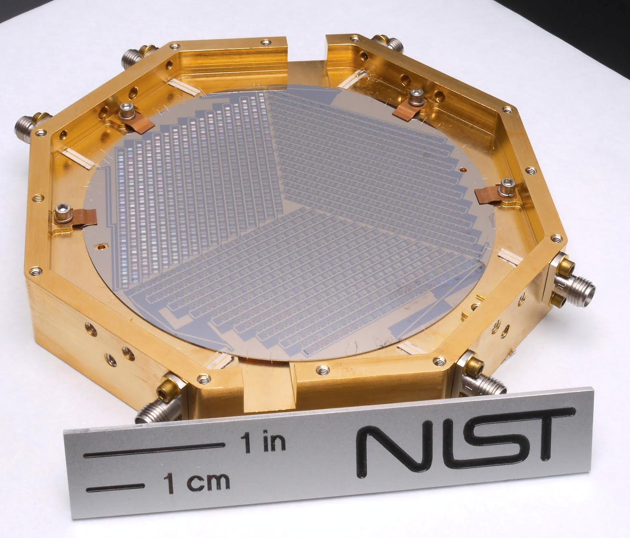
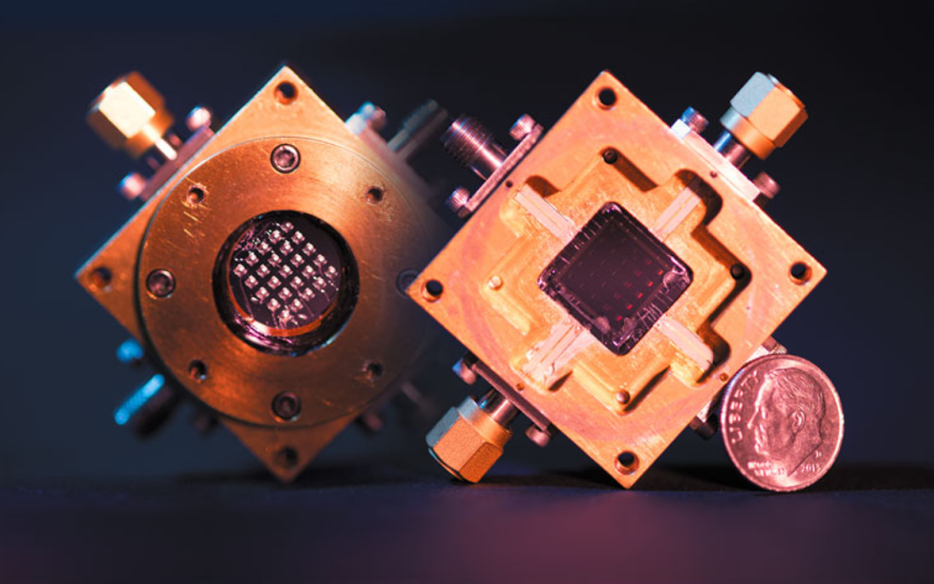
SFMD Technology
Readout Development applies to μMUX-TES, MKIDs, RF- SNSPDs, QCDs which broadly rely on Frequency Division Multiplexing
SFMDs are promising technologies with desirable noise performance. QCDs are stated to offer a NEP of 10⁻¹⁹ W/Hz^½ measured at 1.5THz (required signal power for SNR 1 of 1 Hz bandwidth)
Detector viability in part depends on the technologies ability to scale from 1k pixel arrays to ~500k pixel arrays, where resolution grows sqrt(N), this also presents a challenge to readout system development.
MKID Array
(Image: NIST.gov)
QCD Arrays
(Image: microdevices.jpl.nasa.gov)

Slide 3
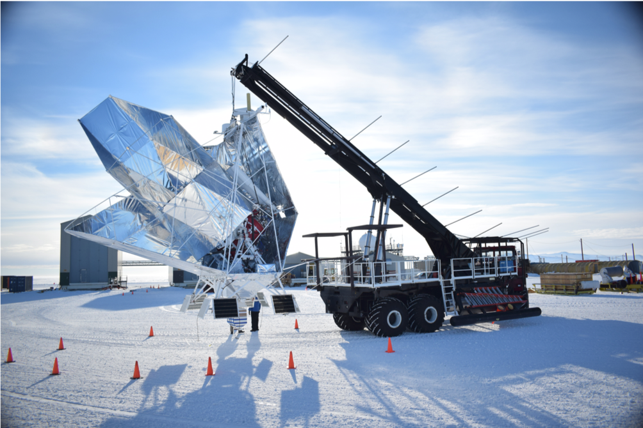
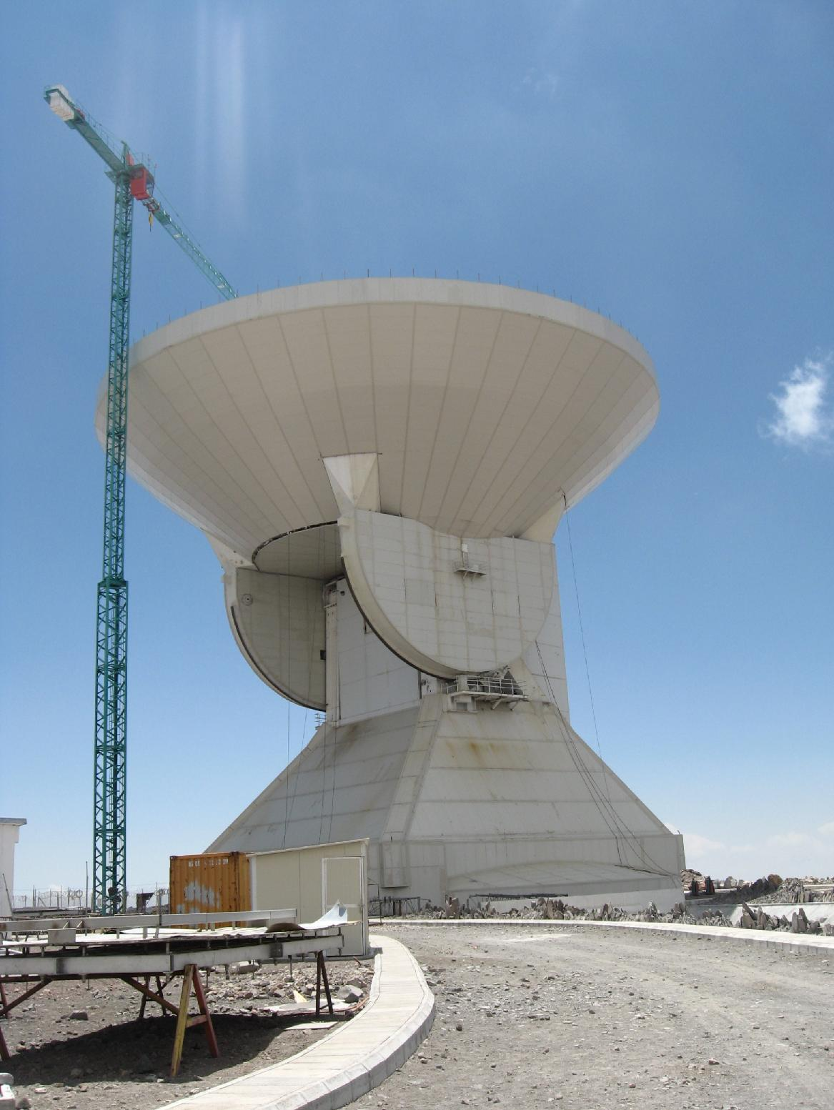
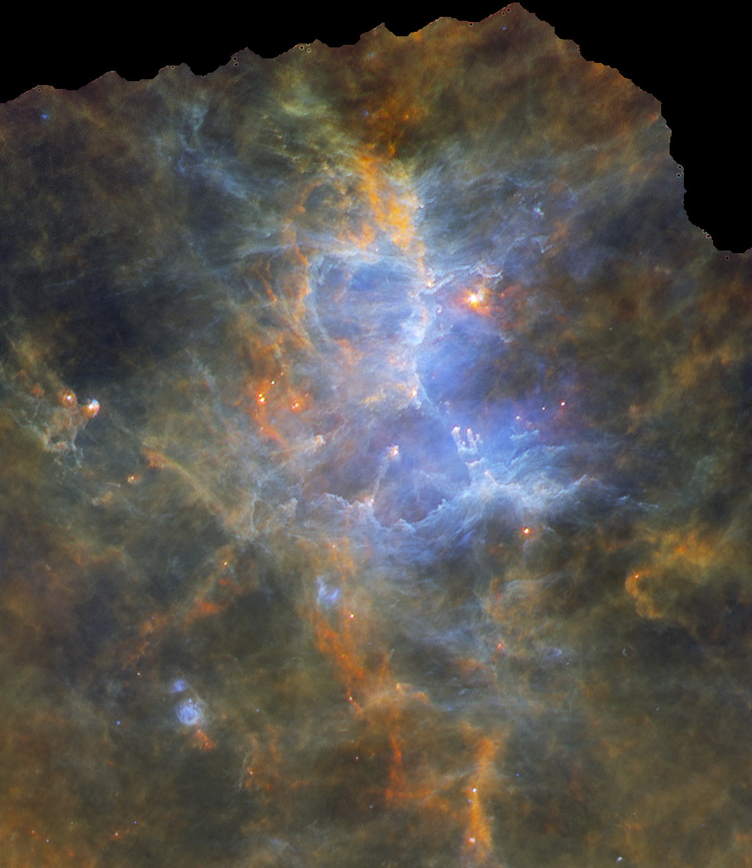
Science Motivation
Underling technology proposed for use with these detectors in service a variety of science missions both balloon and ground based telescopes.
AliCPT - CMB B-modes (Ground Based - China) (μMUX-TES)
Exclaim - intensity mapping (Balloon - NM) (MKIDs)
TIM - TeraHertz intensity Mapping (Balloon - Antarctica) (MKIDs)
BLAST-TNG - ISM polarimeter for star formation (launched, Balloon- Antarctica) (LeKIDs)
TolTEC - Lots of Science (Ground Based - LMT) (MKIDs)
QCDs are a novel detector technology that require development of a new digital demodulation system, proposed candidate for OST
BLAST-TNG Telescope
(Image Credit: BLAST-TNG Collaboration)
Eagle Nebula in far-Infrared
(Image Credit: esa.int)
Large Millimetere Telescope
(Image: Wikipedia)

Slide 4
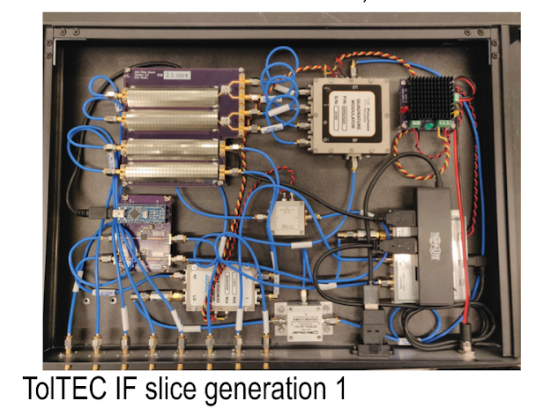
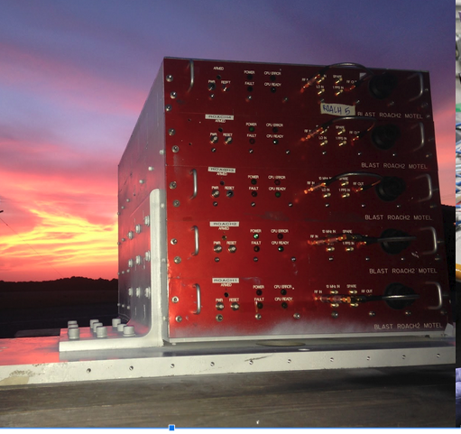
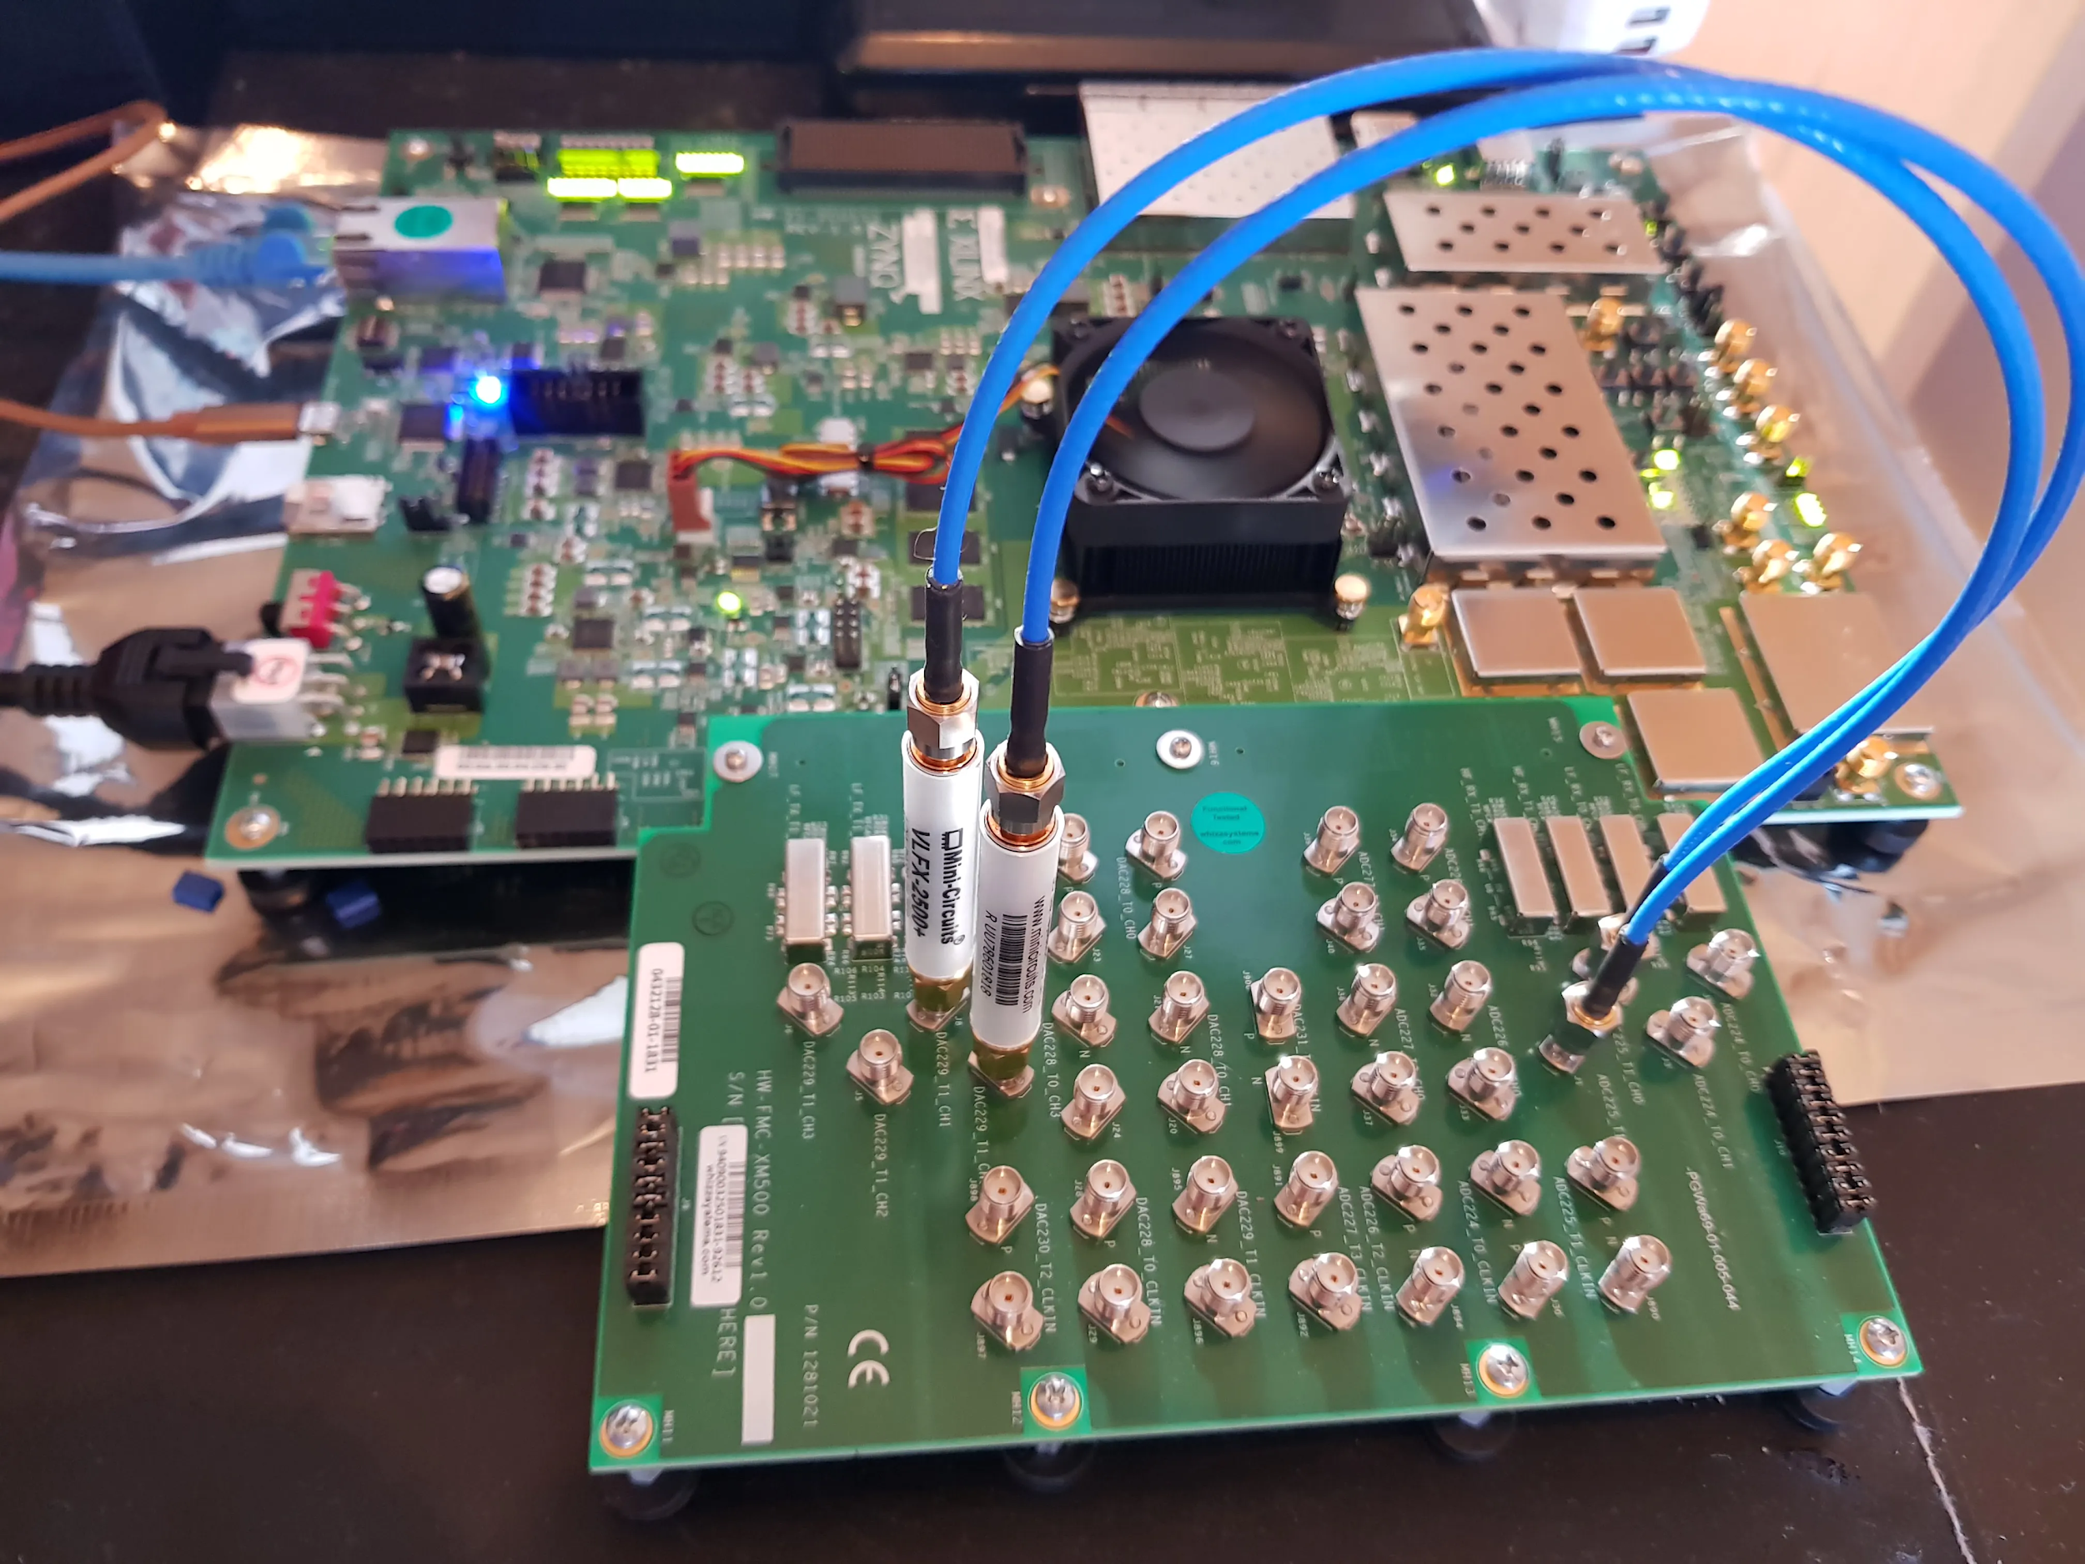
General Readout System
General Readout System entails a RF front end that interfaces between the digitizers and the detectors, set by the requirements of the detectors
Roach Motel (Roach2 based) readout system targeting LeKIDs flew on BLAST-TNG, currently the successor for the warm digital readout is in development using RFSoC FPGAs targeting general SFMD technologies
Design: Eric Weeks
RFSoC (gen2)
Roach Motel (Heritage)

Slide 5
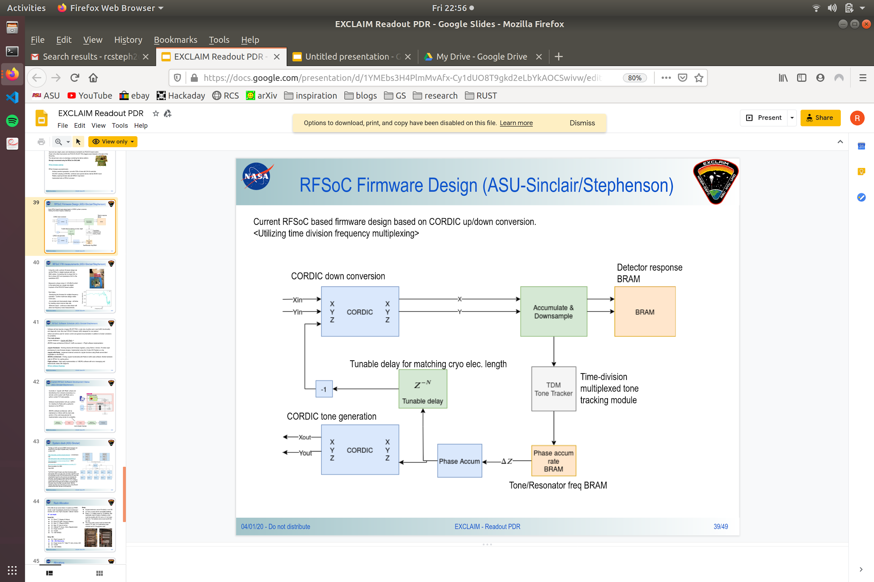
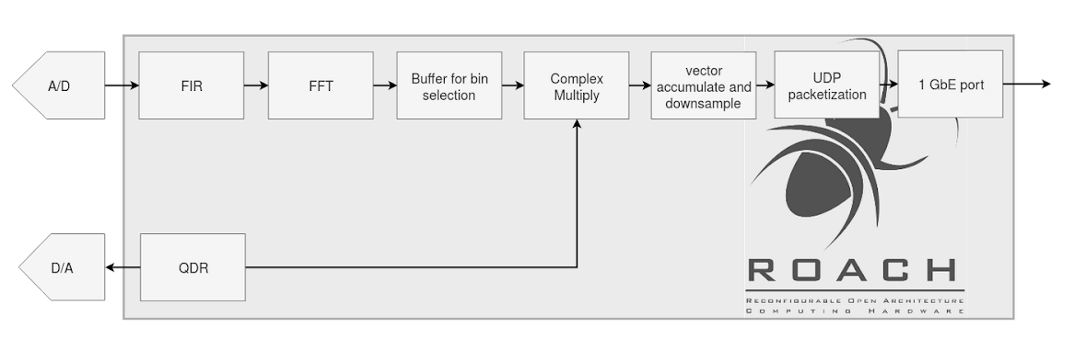
Digital Readout Algorithm
Digital System is responsible for demodulating detector data and producing science data.
Digital Architecture is dependent on the given detector technology, underlying architecture will remain consistent.
FPGAs offer high performance capabilities while remaining reconfigurable.

Slide 6
RF-FPGA
Digital System will utilize the Xilinx UltraScale+ RFSoC ZCU111 FPGA
New System to replace ROACH2 based readout and offer considerable increase in SWaP-C performance
RFSoC uses integrated data converters with D/A: 6GSPS, A/D 4GSPS per channel for 8 channels
Integrated dual core Arm-Cortex processors capable of running linux/python
ZCU111 RFSoC FPGA chip with integrated A/D & D/A
Notes:
FPGAs are desirable technology for detector readouts since they offer high data throughput capabilities and great concurrency.

Slide 7
Results
Current development has been focused on creating Firmware interfaces for the RFSoC.
Dataconveters are now operational with a python interface for tone generation and control. (Redis Interconnect, 1GBE)
Signal processing firmware now in active development (using VHDL)
Current firmware is ready to take detector data when possible, this will help confirm the viability of the digital readout design.

Slide 8
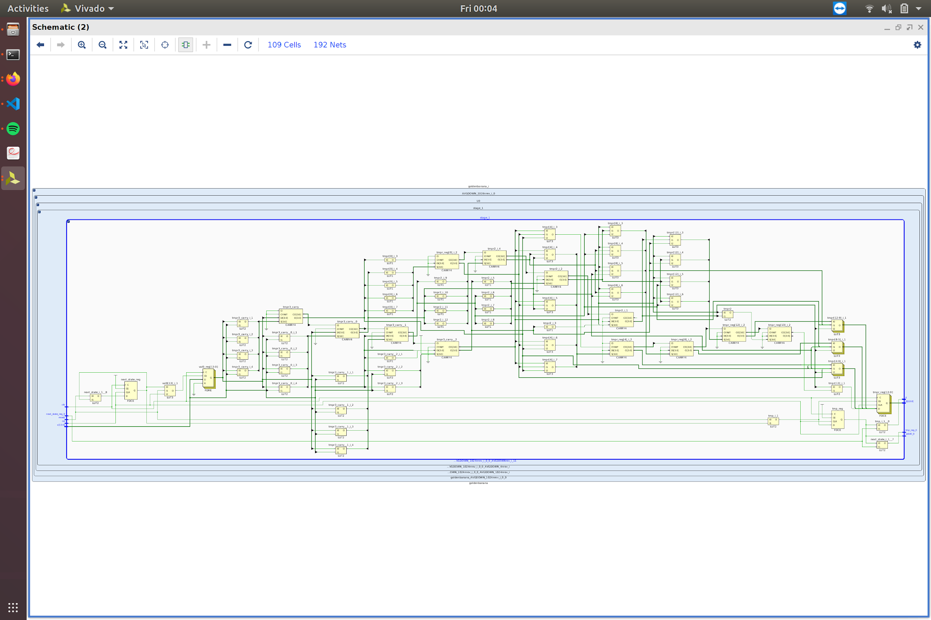
RTL Implementation of 2-State FSM Averager
“ADD last value to current value and DIVIDE by 2 every other clock cycle”

Slide 9
Future Work
Continue development firmware design
Implement Solutions for Multiple SFMD
Create software interface with python to control the RFSoC board for general users
Develop a real-time signal processing algorithm for QCDs.
All firmware/software designs created will be open sourced on github!

Slide 10
The End

